Slide 1
Computer Design Basics

Slide 2
Introduction
Computer Specification
Instruction Set Architecture (ISA) - the specification of a computer's appearance to a programmer at its lowest level
Computer Architecture - a high-level description of the hardware implementing the computer derived from the ISA
The architecture usually includes additional specifications such as speed, cost, and reliability.

Slide 3
Simple Computer Architecture
Simple computer architecture decomposed into:
Datapath for performing operations
Control unit for controlling datapath operations
A datapath is specified by:
A set of registers
The microoperations performed on the data stored in the registers
A control interface

Slide 4
Datapaths
The set of registers
A set of registers with common access resources called a register file
Microoperation implementation
Buses - shared transfer paths
Arithmetic-Logic Unit (ALU) - shared resource for implementing arithmetic and logic microoperations
Shifter - shared resource for implementing shift microoperations

Slide 5
Datapath Example
Four parallel-load registers
Two mux-based register selectors
Register destination decoder
Mux B for external constant input
Buses A and B with external address and data outputs
ALU and Shifter with Mux F for output select
Mux D for external data input
Logic for generating status bits V, C, N, Z

Slide 6
Datapath Example: Performing a Microoperation
Microoperation: R0 ← R1 + R2
Apply 01 to A select to place contents of R1 onto Bus A
Apply 10 to B select to place contents of R2 onto B data and apply 0 to MB select to place B data on Bus B
Apply 0010 to G select to perform addition G = Bus A + Bus B
Apply 0 to MF select and 0 to MD select to place the value of G onto BUS D
Apply 00 to Destination select to enable the Load input to R0
Apply 1 to Load Enable to force the Load input to R0 to 1 so that R0 is loaded on the clock pulse (not shown)
The overall microoperation requires 1 clock cycle

Slide 7
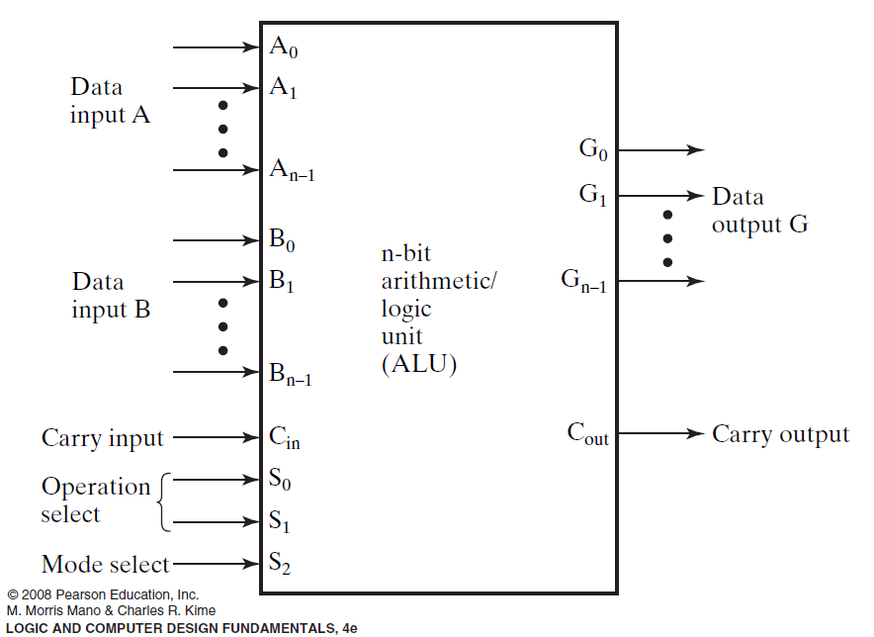
Arithmetic Logic Unit (ALU)
Decompose the ALU into:
An arithmetic circuit
A logic circuit
A selector to pick between the two circuits

Slide 8
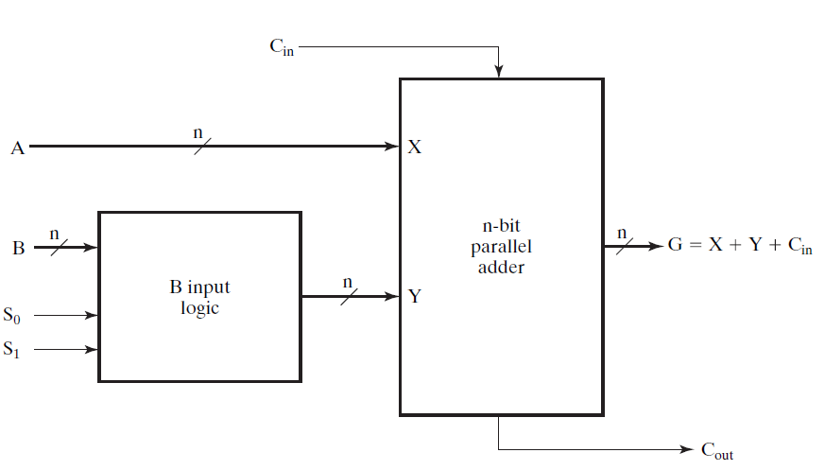
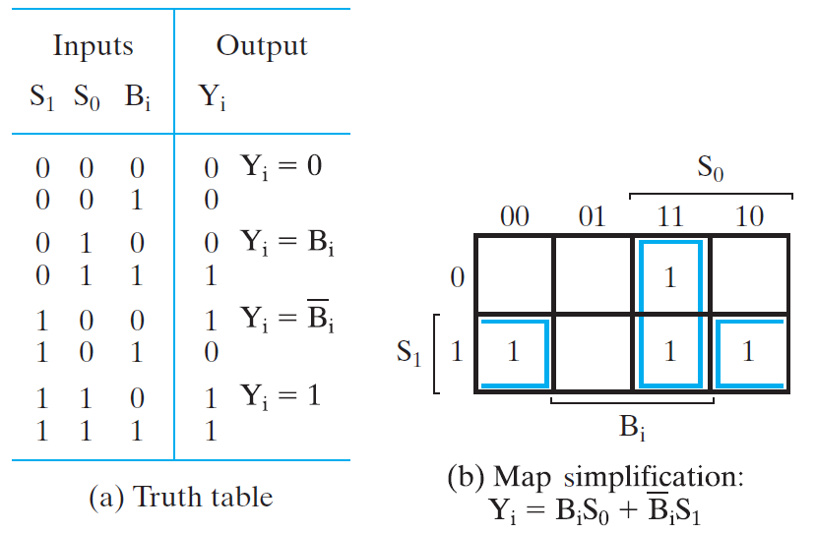
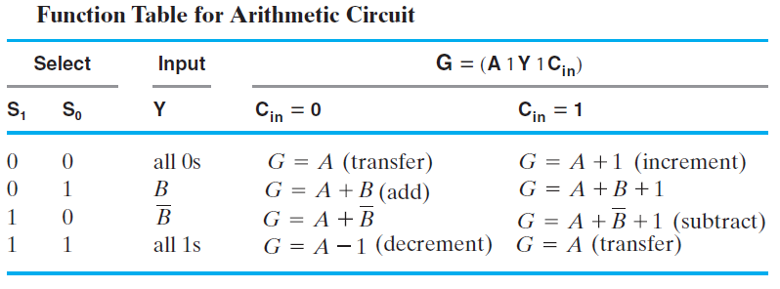
Arithmetic Circuit Design

Slide 9
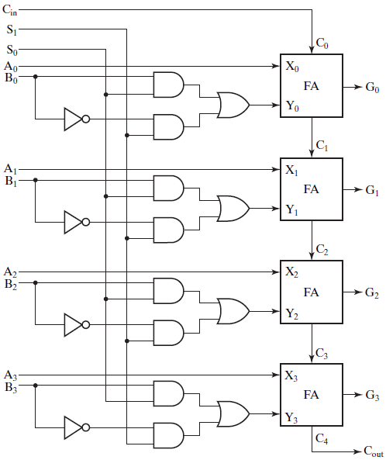
Example: 4-bit Arithmetic Circuit

Slide 10
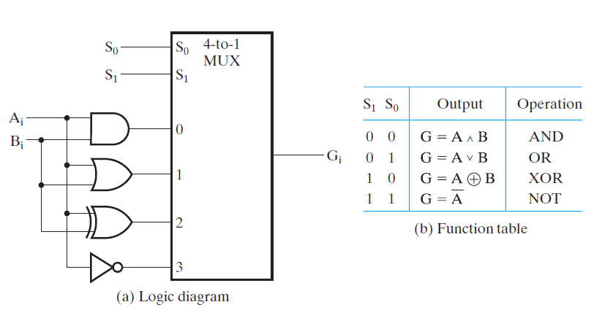
Logic Circuit

Slide 11
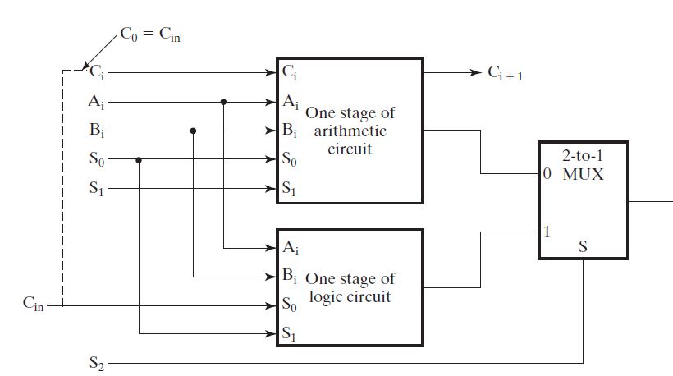
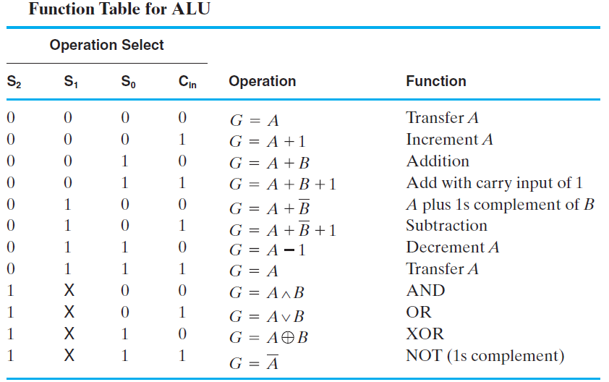
Arithmetic Logic Unit (ALU)
Gi

Slide 12
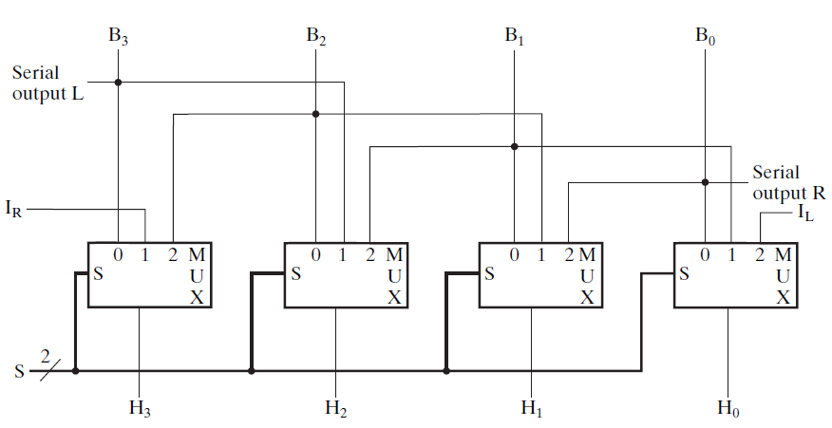
The Shifter
4-Bit Basic Shifter

Slide 13
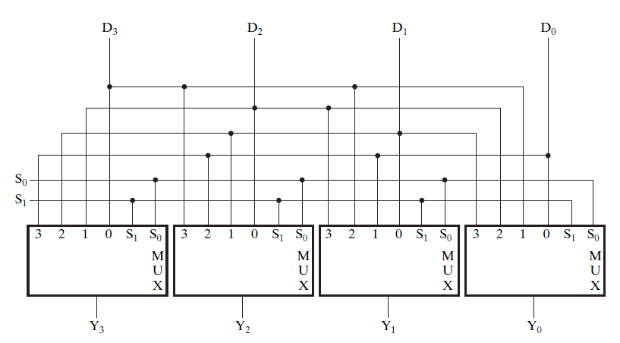
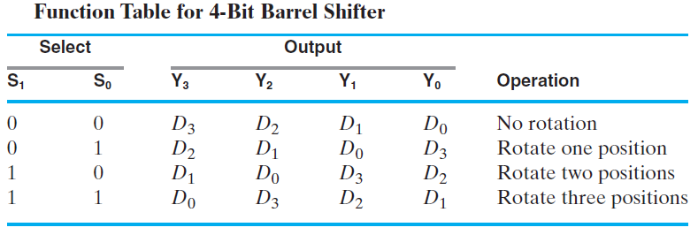
Barrel Shifter

Slide 14
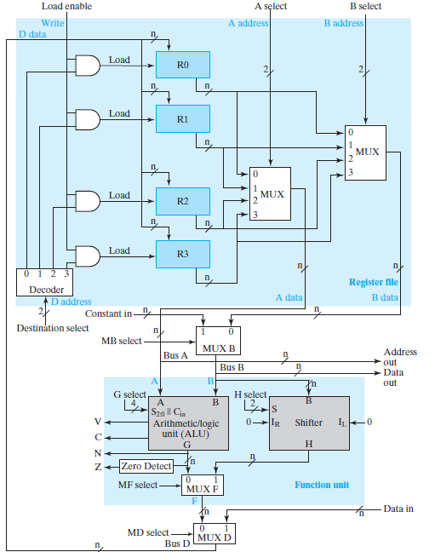
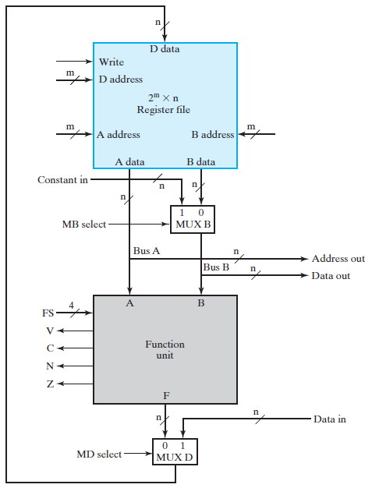
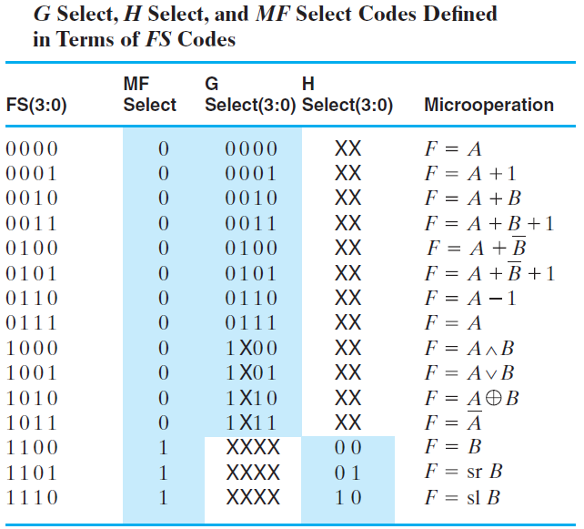
Datapath Representation
Boolean Equations:
MFS = F₃ F₂
GS_{i} = F_{i}
HS_{i} = F_{i}

Slide 15
Datapath With Function Unit Select Codes
G
Select,
H
Select,
and
MF
in T
of
FS
Codes

Slide 16
The Control Word
The datapath has many control inputs
The signals driving these inputs can be defined and organized into a control word
To execute a microinstruction, we apply control word values for a clock cycle.
For most microoperations, the positive edge of the clock cycle is needed to perform the register load

Slide 17

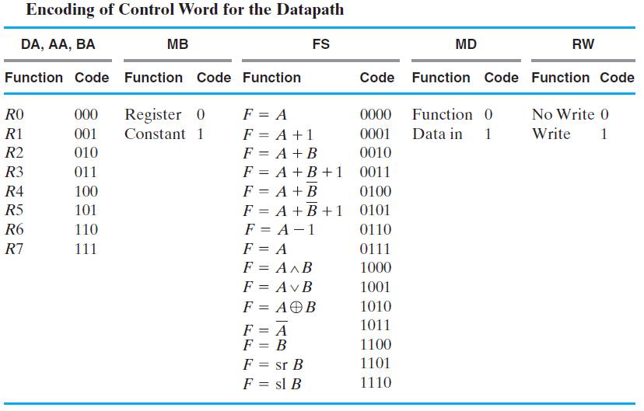
Control Word
n
R
W
0
Write
D data
15
D
A
14
D address
13
8
x
n
Register file
12
9
AA
11
A address
B address
8
BA
10
A data
B data
7
n
n
Constant in
n
1
0
MB
6
MUX B
Bus A
n
Address out
Bus B
n
Data out
A
B
V
5
C
Function
4
FS
N
unit
3
Z
2
n
n
Data in
0
1
MD
1
MUX D
Bus D

Slide 18
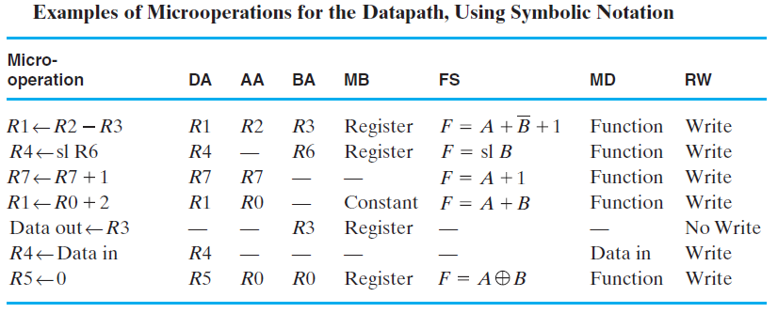
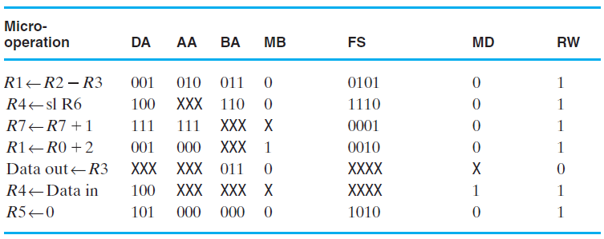

Slide 19
Datapath Simulation
n
R
W
0
Write
D data
15
D
A
14
D address
13
8
x
n
Register file
12
9
AA
11
A address
B address
8
BA
10
A data
B data
7
n
n
Constant in
n
1
0
MB
6
MUX B
Bus A
n
Address out
Bus B
n
Data out
A
B
V
5
C
Function
4
FS
N
unit
3
Z
2
n
n
Data in
0
1
MD
1
MUX D
Bus D

